Slide 1
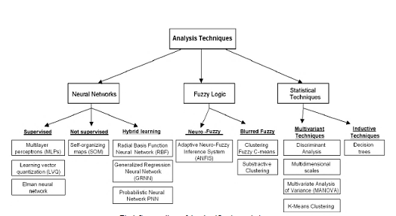
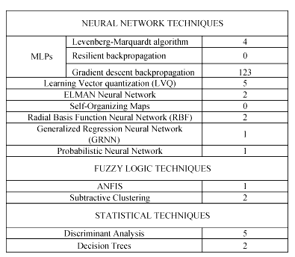
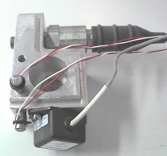
Universidad Miguel Hernandez
Self Organizing Maps in comparison with other neural networks for the identification of Pacejka formula parameters of lateral break force vs slippage.
C. Senabre*, E. Velasco*, S. Valero*
* Depto. Ingeniería Mecánica y Energía. Universidad Miguel Hernández, Elche España
The objective of the research is to prove the capability of self-organising maps (SOMs) to classify lateral brake formula of a vehicle on a bank of roller tester from the MOT (Ministry of transport) and on flat ground.
F_{y} = D sen{C atan[B(1- E)X + E/B *atan(B * X)] }
X=SLIPPAGE
B: STIFFNESS FACTOR
C: SHAPE FACTOR
D: MAXIMUM VALUES OF BRAKE
$$\text{E}=\frac{Bx_{m}−tan[\frac{π}{2C}]}{Bx_{m}−arctan(Bx_{m})}$$
Lateral Force data base
vs Slippage angle
Fig 1: Neural networks studied
Methods: With experimental data
We must stand out that SOM methodology identify the most similar curve from the data bank to the new experimental array after comparing results with other neural network techniques, see fig 1 and 2. But if there is not any curve equal SOM gives as result a group of curves. So If you get the media of that group of curves you get the equal curve to the experimental data.
Using a data base of all possible values of Pacejka coefficients (X, B, C, D) for the mathematical model for Lateral Force, Fy, the neural network demonstrated good generation of the lateral brake-slide relationship when presented with data not used in network training. This tool will easily find brake-slide equation of each experience and we will compare the brake on two different experimental tests.
Graphs
Acknowledgements to Universidad Miguel Hernández for all the support given during this research.
Fig 2: Neural networks errors

