Slide 1
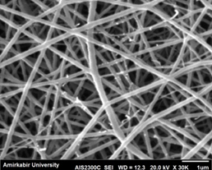
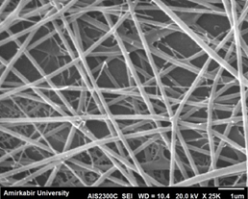
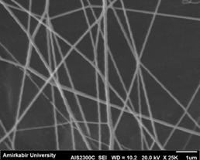
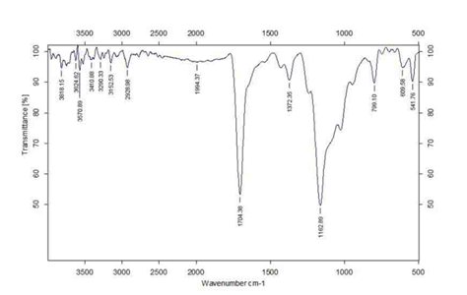
Fabrication and characterization of Polyvinyl alcohol nanofiber
Nazanin Ghafari , Sima Habibi , Azam Talebian
Islamic Azad University, Yadegar-e-Imam Khomeini(RAH) Shahr-e-Rey Branch, Textile Department
Khalij Fars Highway. Tehran, Iran
Introduction
Results & Discussions
Tables
Nanotechnology is the study and application of extremely small things(a bout 1to100 nanometers)And can be used across all the other science fields, such as chemistry, biology, physics, materials sciences and engineering. Polymeric Nanofibers as one of the most known Nanotechnology products in which have huge potential applications in many fields due their high aspect ratio and porosity. The three dimensional feature of the product, results in having high capability in mechanical and biological properties. Electrospinning is a simple and inexpensive method of producing Nanofibers in which for their unique structure can be used in tissue engineering. Polyvynil Alcohal(PVA) is a biocompatible and water soluble synthetic polymer, that is easily electrospinning. Typically PVA is a soluble in water but in fact the water can decrease the solubility of some polymers, hence blending these polymers with PVA can solve this problem. In this work, PVA prepared by formic acid which has less affection on degradation and it is of low toxicity
Characterization
Figure 1 shows the nanofibers at different voltages. The diameter of 16,18,22Kv voltages ranged between 110-210 nm, 70-180nm and 70-100nm, respectively
FTIR study
Figure 2 shows the FTIR of PVA. Appearance of signal around (3000-2850)cm-1 is due to CH.The signals around (1750-1690) cm-1 show C=O stretching. Signal at 1162.89 cm-1 shows H bonded.signal around 3200cm-1 due to hydrogen bonded – OH.
Aim
The main objective of this work is focuses on effect of distance and voltage paramerts on morphology and diameter of nanofibers.The morphology of electrospun PVA nanofibers were characterized by using scanning electron microscope(SEM) and Fourier transform infrared spectrometer(FTIR).
Fig1.SEM micrograph of a) PVA of 16Kv b)PVA of 18Kv c)PVA of 22Kv
Methods & Materials
Graphs
Materials: The materials which were used in this work include: (a)medium molecular weight poly vinyl alcohol powder with DD=87-89% from BDH Chemicals.(b) Formic acid (HCOOH) and (c)deionized water
Electrospinning and Test
Poly vinyl alcohol was dissolved in concentrated formic acid (98%) at room temperature. Electrospinning unit from KATO TECH CO. was used . The syringe used had 18 gauge needle(capillary diameter,1.20 mm).The applied voltage was different( 16-18-22) kV and tip –to-collector distances and flow rate were fixed at 150 mm and 0.07 mm/min ,respectively . The morphology of the electrospun mats were observed by a BAL-TEC SCD 005 scanning electron microscope. characterization of chemical structure of the nanofiber samples was done by FTIR technique(Tensor 27 , Bruker).
Conclusion
Nanofibers of PVA prepared by acetic acid were fabricated using electrospinning. The effect of voltag on morphology of nanofibers was investigated using SEM and FTIR. Incorporation of pva with polymer can facilitate electrospinning of them
Figure 2. FTIR of nanofiber of Polyvinyl alcohol

