Slide 1



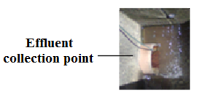
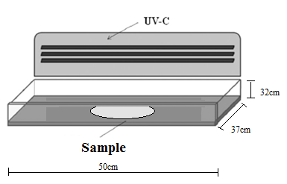
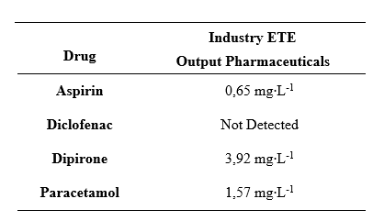
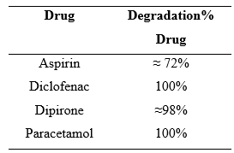



EVALUATION AND TREATMENT DRUGS IN WASTEWATER TREATMENT PLANT USING ADVANCED OXIDATIVE PROCESSES
Authors: Daniella Carla Napoleão, Joan Manuel Rodriguez Diaz, Léa Elias Mendes Carneiro Zaidan,
Yasmany Rodriguez Diaz, Mohand Benachour, Valdinete Lins da Silva
INTRODUCTION AND OBJECTIVES
The study of the pollution of water matrices is increasing and is continuous between the members of the scientific community and because of which drinking and water fit for human consumption considerably decreases each year. Identifying and quantifying the different classes of pollutants is extremely necessary, especially when we see that among the most identified compounds are drugs. Use of contaminants is increased by the world\'s population without specific control to its discharge to the environment. Effluents from different origin were collected and analyzed for the presence of four drugs studied before and after application of AOP, by analysis via liquid chromatography high efficiency (HPLC). To ensure data reliability methodology, validation was performed using HPLC as required by competent bodies (ANVISA and INMETRO). The use of advanced oxidation processes (AOP) are the object of study and as an alternative capable of promoting the degradation of pollutants from contaminated means. This study aims to assess, identify and quantify the drugs, aspirin, diclofenac, dipirone and paracetamol in different effluents from wastewater treatment plants for use of different AOP.
RESULTS AND DISCUSSION
Determination and quantification of drugs by HPLC and analysis of TOC
Determination and quantification of drugs by HPLC and analysis of TOC
Total organic carbon analyzes were performed to verify the conversion of organic after treatment. Among the drugs studied, three of them were detected in effluents at concentrations ranging from 0.29 mgL⁻¹ to 3.96 mgL⁻¹. The best results were obtained using a bench reactor employing like Photo-Fenton process which observed degradation of drug from 71.9% to 100.0%, and a conversion of organic matter equal to 66.5%.
Treatment AOP (Bench Reactor)
HPLC
HPLC
DOPING DICLOFENAC
ACKNOWLEDGEMENTS
NUQAAPE

